Slide 1
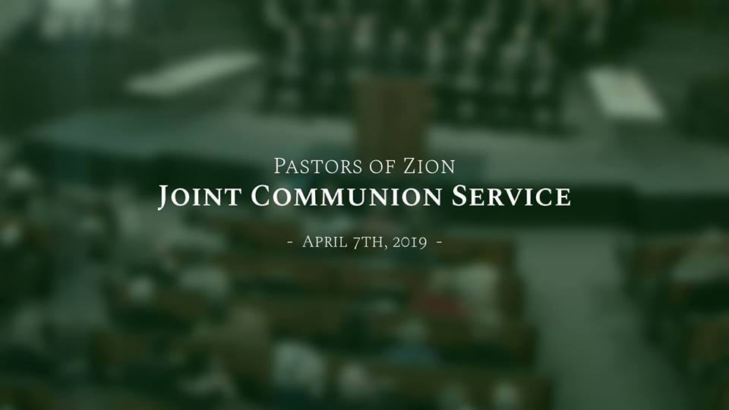

Slide 2
“Jesus Loves Me”
Bob Davis, organist

Slide 3
Jesus loves me, this I know,
For the scriptures tell me so;
Little ones to Him belong,
They are weak, but He is strong.
Yes, Jesus love me,
Yes, Jesus love me,
Yes, Jesus loves me,
The scriptures tell me so.
“Jesus Loves Me”

Slide 4
I love Jesus, yes, I do,
Jesus loves both me and you;
I will love Him to the end;
Jesus is the children’s friend.
Yes, I love Jesus,
Yes, I love Jesus,
Yes, I love Jesus,
Oh, won’t you love Him too.
“Jesus Loves Me”

Slide 6
“Come, O Thou King of Kings”
Bob Davis, organist

Slide 7
Come, O Thou King of Kings!
We’ve waited long for Thee,
With healing in Thy wings,
To set Thy people free.
Come, Thou desire of nations, come;
Come, Thou desire of nations, come;
Let Israel now be gathered home.
“Come, O Thou King of Kings!”

Slide 8
Come make an end of sin,
And cleanse the Earth by fire;
And righteousness bring in
That saints may tune the lyre
With songs of joy—a happier strain,
With songs of joy—a happier strain,
To welcome in Thy peaceful reign.
“Come, O Thou King of Kings!”

Slide 9
Hosannas now shall sound
From all the ransomed throng,
And glory echo round
A new triumphal song,
The wide expanse of Heaven fill,
The wide expanse of Heaven fill,
With anthems sweet from Zion’s hill.
“Come, O Thou King of Kings!”

Slide 10
Hail! Prince of life and peace!
Thrice welcome to Thy throne!
While all the chosen race
Their Lord and Savior own.
The heathen nations bow the knee;
The heathen nations bow the knee;
And every tongue gives praise to Thee!
“Come, O Thou King of Kings!”

Slide 12
“Precious Name”
Bob Davis, organist

Slide 13
Bow, ye mortals, bow before Him,
Bow and keep His sacred word;
Bow in reverence and adore Him,
Bow, confess your Savior Lord.
Bow, ye angels, chant His praises,
Strike your lyres with one accord,
While each voice melodious raises
Paeans unto Christ, the Lord.
“Precious Name”

Slide 14
Men and angels, seraphs joining,
In one grand harmonious chord,
Voice and instrument combining,
All confess that Christ is Lord.
“Precious Name”

Slide 16
“Hail to the Brightness”
Bob Davis, organist

Slide 17
Hail to the brightness of Zion’s glad morning,
Joy to the lands that in darkness have lain;
Hushed be the accents of sorrow and mourning,
Zion in triumph begins her mild reign.
Jail to the brightness of Zion’s glad morning,
Long by the prophets of Israel foretold;
Hail to the millions from bondage returning,
Gentiles and Jews the blest vision behold.
“Hail to the Brightness”

Slide 18
See, from all lands, from the isles of the ocean,
Praise to Jehovah ascending on high;
Fallen the engines of war and commotion,
Shouts of salvation are rending the sky.
“Hail to the Brightness”

Slide 20
“Admonition”
Bob Davis, organist

Slide 21
“O my people,” saith the Spirit,
“Hear the word of God today;
Be not slothful, but obedient;
‘Tis the world’s momentous day!
Unto honor I have called you—
Honor great as angels know;
Heed ye, then, a Father’s counsel,
And by deeds your purpose show.”
“Admonition”

Slide 22
“Time is ripe! My work must hasten!
Whoso will may bide the hour.”
Naught can harm whom God protecteth—
Elements confess His power.
“Up ye, then, to the high places
I have bid you occupy!
Peril waits upon the heedless,
Grace upon the souls who try!”
“Admonition”

Slide 23
“Love ye me and love all people—
Love as I have loved you;
This your calling– this my purpose—
Thus be my disciples true.
Then in this exalted station,
Your companion I will be;
Every promise of my Scriptures
Will be verified in Thee.”
“Admonition”

Slide 24
“Get ye up, then, to your mountain,
Zion of this closing day!
For the glory of my coming
Waits to break upon your way!
Forth from thence your testimony
Shall to trembling nations go,
And the world confess that with you
God has residence below.”
“Admonition”

Slide 26
Pastors of Zion
Elder Dayn Cederstrom
Welcome

Slide 27
“Redeemer of Israel”
Bob Davis, organist

Slide 28
Redeemer of Israel, our only delight,
On whom for a blessing we call,
Our shadow by day, and our pillar by night,
Our King our Companion, our All!
We know he is coming to gather His sheep
And plant them in Zion in love;
For why in the valley of death should they weep
Or alone in the wilderness rove?
“Redeemer of Israel”

Slide 29
How long we have wandered as strangers in sin
And cried in the desert for Thee!
Our foes have rejoiced when our sorrows they’ve seen,
But Israel will shortly be free.
As children of Zion, good tidings for us,
The tokens already appear;
Fear not and be just, for the Kingdom is ours,
And the hour of redemption is near.
“Redeemer of Israel”

Slide 31
Outreach Restoration Branch
Elder Larry Hodges
Invocation

Slide 32
Atherton Restoration Branch
Elder Jason Howard
Offertory

Slide 33
Grain Valley Restoration Branch
Jill Etter
Ministry of Music

Slide 34
Oak Grove Restoration Branch
Elder Eric English
Communion Message

Slide 35
“Behold the Lamb”
Bob Davis, organist

Slide 36
Behold the Lamb who bears our sins away,
Slain for us – and we remember
The promise made that all who come in faith
Find forgiveness at the cross.
So, we share in this bread of life,
And we drink of His sacrifice
As a sign of our bonds of peace
Around the table of the King.
“Behold the Lamb”

Slide 37
The body of our Savior Jesus Christ,
Torn for you – eat and remember
The wounds that heal, the death that brings us life
Paid the price to make us one.
So, we share in this bread of life,
And we drink of His sacrifice
As a sign of our bonds of love
Around the table of the King.
“Behold the Lamb”

Slide 38
The blood that cleanses every stain of sin,
Shed for you – drink and remember
He drained death’s cup that all may enter in
To receive the life of God.
So, we share in this bread of life,
And we drink of His sacrifice
As a sign of our bonds of love
Around the table of the King.
“Behold the Lamb”

Slide 39
And so, with thankfulness and faith we rise
To respond, - and to remember
Our call to follow in the steps of Christ
As His body here on earth.
As we share in His suffering
We proclaim Christ will come again!
And we’ll join in the feast of heaven
Around the table of the King.
“Behold the Lamb”

Slide 41
Waldo Ave Restoration Branch
Elder Jon Tandy
Blessing of the Bread

Slide 42
Grain Valley Restoration Branch
Bishop Joe Burkart
Blessing of the Wine

Slide 43
Grain Valley Restoration Branch
Jill Etter
Ministry of Music

Slide 44
Hill Cumorah Branch
Elder Russ Howard
Pastoral Prayer

Slide 45
“The Spirit of God Like a Fire is Burning”
Bob Davis, organist

Slide 46
The Spirit of God like a fire is burning;
The latter-day glory begins to come forth;
The visions and blessings of old are returning;
The angels are coming to visit the Earth.
We’ll sing and we’ll shout with the armies of heaven,
“Hosannah, hosannah to God and the Lamb!”
Let glory to them in the highest be given
Henceforth and forever! Amen, and Amen!
“The Spirit of God, Like a Fire is Burning”

Slide 47
The Lord is extending His saints’ understanding,
Restoring their judges and all as at first;
The knowledge and power of God are expanding;
The veil o’er the Earth is beginning to burst!
We’ll sing and we’ll shout with the armies of heaven,
“Hosannah, hosannah to God and the Lamb!”
Let glory to them in the highest be given
Henceforth and forever! Amen, and Amen!
“The Spirit of God, Like a Fire is Burning”

Slide 48
We call in our solemn assemblies, in spirit,
To spread forth the kingdom of heaven abroad,
That we through our faith may begin to inherit
The visions and blessings and glories of God.
We’ll sing and we’ll shout with the armies of heaven,
“Hosannah, hosannah to God and the Lamb!”
Let glory to them in the highest be given
Henceforth and forever! Amen, and Amen!
“The Spirit of God, Like a Fire is Burning”

Slide 50
Living Hope Restoration Branch
Elder Rick Gard
Benediction

